Slide 1
Desired State Configuration

Slide 2
Disclaimer: My DSC Background
General tinkering
Reading on the interwebs
Usage of the push model
Sharing what I find useful

Slide 3
What is PowerShell Desired State Configuration (DSC)?
Declarative vs. Imperative (https://www.upguard.com/blog/articles/declarative-vs.-imperative-models-for-configuration-management)
Normal PowerShell scriptings = imperative = how
DSC PowerShell scriptings = declarative = what

Slide 4
The Basic Commands
Configuration
Get-DscConfiguration
Start-DscConfiguration
Test-DscConfiguration
Get-Command -Module PSDesiredStateConfiguration

Slide 5
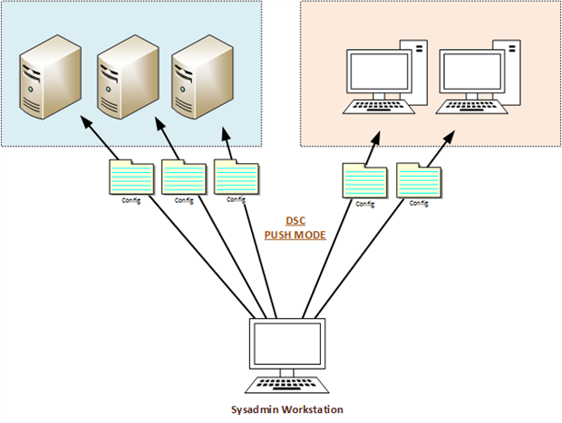
Push Model Stolen from Nicolas Prigent’s excellent series (https://www.simple-talk.com/sysadmin/powershell/powershell-desired-state-configuration-the-basics/)

Slide 6
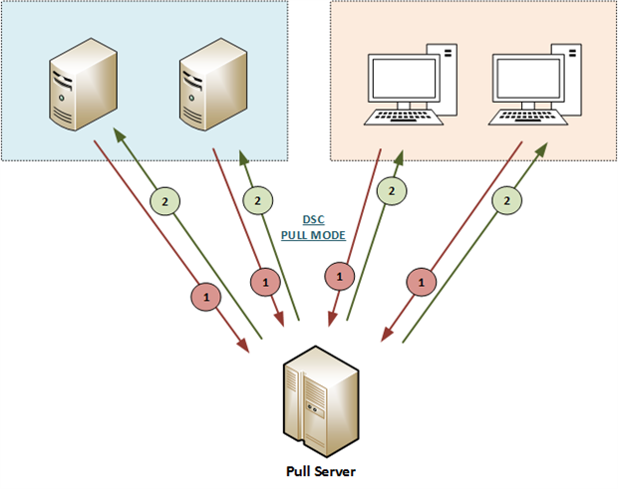
Pull Model Stolen from Nicolas Prigent’s excellent series (https://www.simple-talk.com/sysadmin/powershell/powershell-desired-state-configuration-the-basics/)

Slide 7
My thoughts…
Push model = scripting a server / application configuration with a whole LOT less coding

Slide 8
On to the Code…

